Slide 1
Proximity Measures
Prof.Aruna Malapati

Slide 2
Learning Objective
Define proximity/similarity
Dissimilarity/Similarity for Binary Attributes and its variants

Slide 3
Proximity
For many problems we need to quantify how close two objects are.
Examples:
For an item bought by a customer, find other similar items
Group together the customers of site so that similar customers are shown the same ad.
Group together web documents so that you can separate the ones that talk about politics and the ones that talk about sports.
Find all the near-duplicate mirrored web documents.
Find credit card transactions that are very different from previous transactions.
To solve these problems we need a definition of similarity, or distance.

Slide 4
Proximity (contd..)
Similarity
Numerical measure of how alike two data objects are.
Is higher when objects are more alike.
Often falls in the range [0,1]
Examples: Cosine,Jaccard,Tanimoto
Dissimilarity
Numerical measure of how different two data objects are
Lower when objects are more alike
Minimum dissimilarity is often 0
Upper limit varies

Slide 5
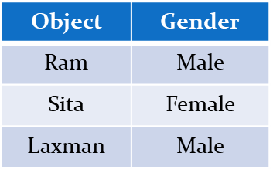
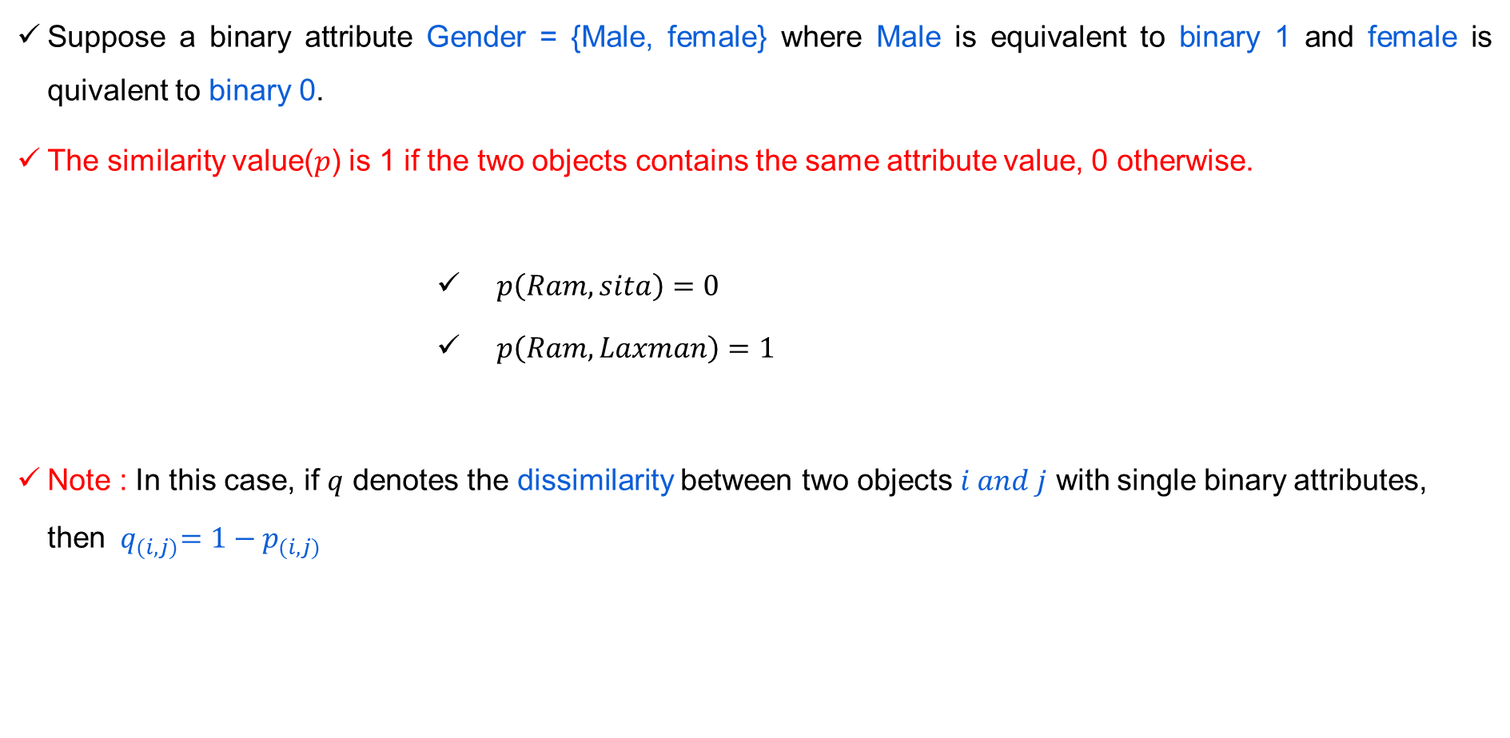
Proximity Measures for Single Nominal attribute
Suppose a binary attribute Gender = {Male, female} where Male is equivalent to binary 1 and female is quivalent to binary 0.
The similarity value($p$) is 1 if the two objects contains the same attribute value, 0 otherwise.
$p\left(Ram, sita\right)=0$
$p\left(Ram, Laxman\right)=1$
Note : In this case, if $q$ denotes the dissimilarity between two objects $i and j$ with single binary attributes, then ${{ q}_{(i,j)}=1−p}_{(i,j)}$

Slide 6
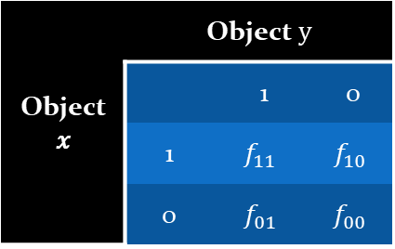
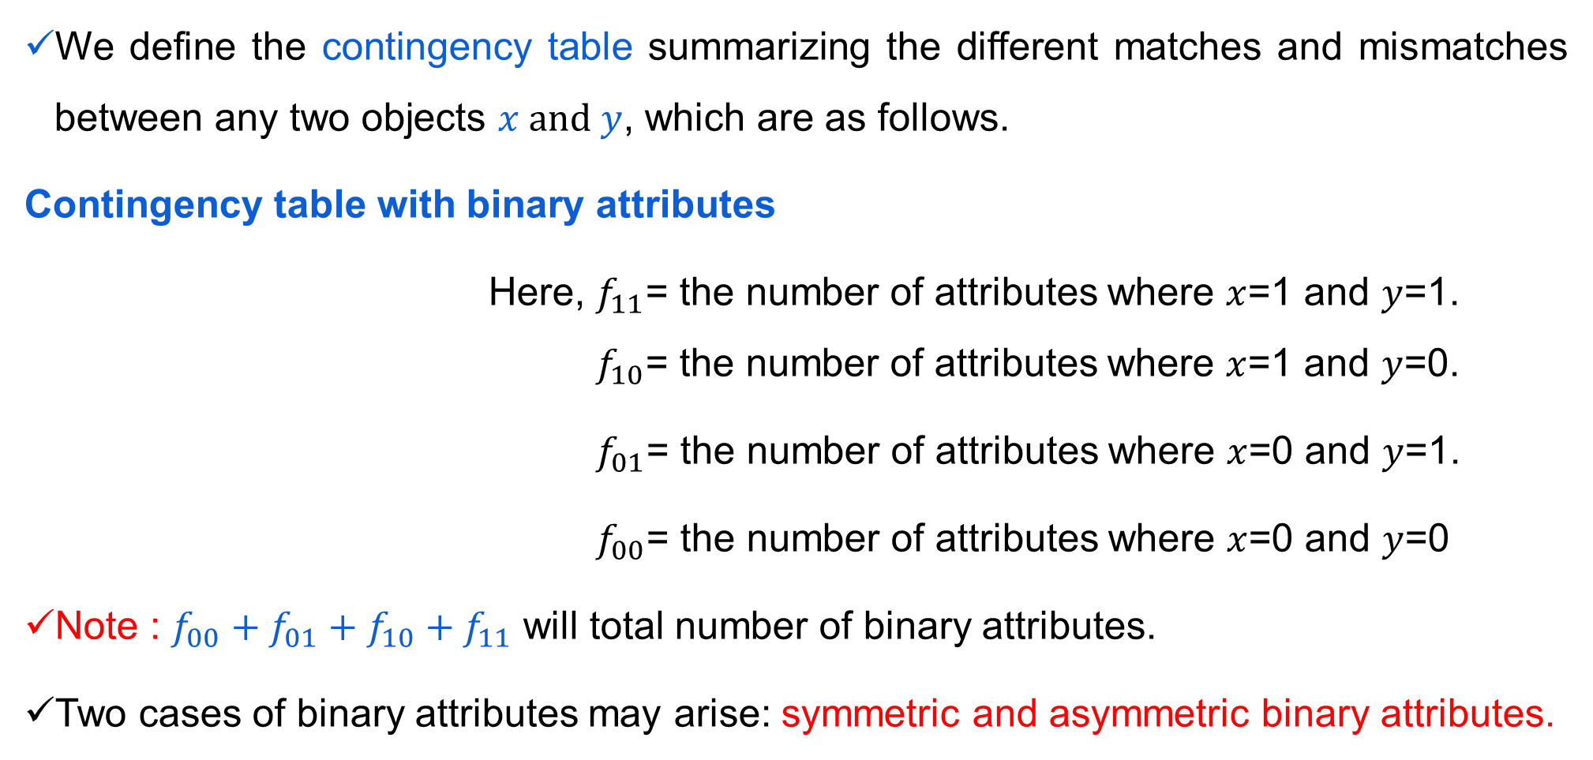
Proximity Measures for Two or more Nominal attribute
We define the contingency table summarizing the different matches and mismatches between any two objects $x and y$, which are as follows.
Contingency table with binary attributes
Here, $f_{11}$= the number of attributes where $x$=1 and $y$=1. $f_{10}$= the number of attributes where $x$=1 and $y$=0.
$f_{01}$= the number of attributes where $x$=0 and $y$=1.
$f_{00}$= the number of attributes where $x$=0 and $y$=0
Note : $f_{00}+f_{01}+f_{10}+f_{11}$ will total number of binary attributes.
Two cases of binary attributes may arise: symmetric and asymmetric binary attributes.

Slide 7
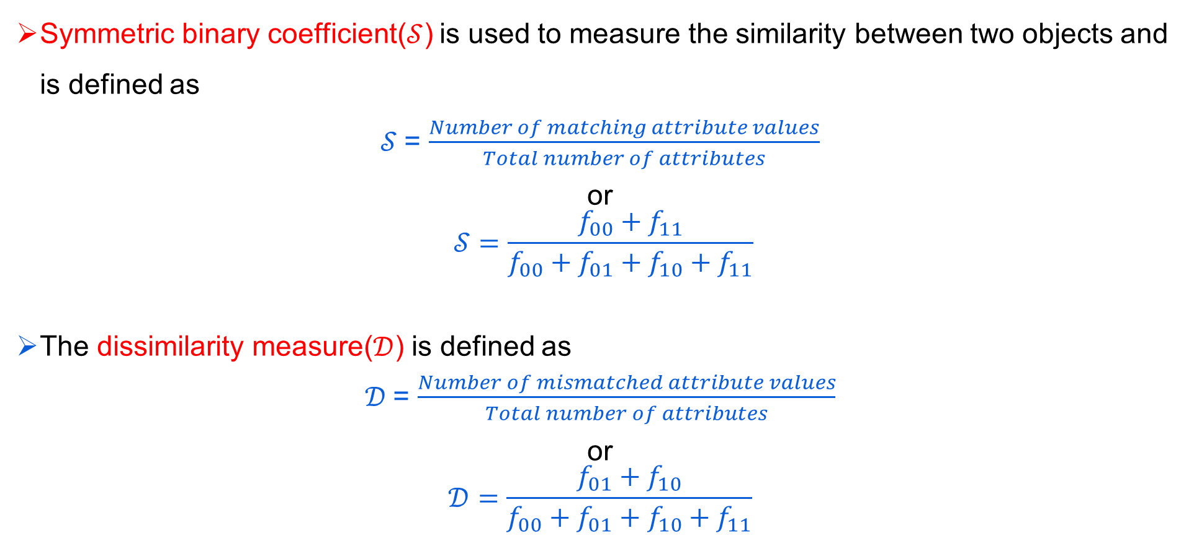
Similarity Measure for Symmetric Binary attribute
Symmetric binary coefficient($𝒮$) is used to measure the similarity between two objects and is defined as
$𝒮$= $\frac{Number of matching attribute values}{Total number of attributes}$
or
$$𝒮=\frac{f_{00}+f_{11}}{f_{00}+f_{01}+f_{10}+f_{11}}$$
The dissimilarity measure($𝒟$) is defined as
$𝒟$= $\frac{Number of mismatched attribute values}{Total number of attributes}$
or
$$𝒟=\frac{f_{01}+f_{10}}{f_{00}+f_{01}+f_{10}+f_{11}}$$
Notes:
Note that, $𝒟=1−$ $𝒮$

Slide 8
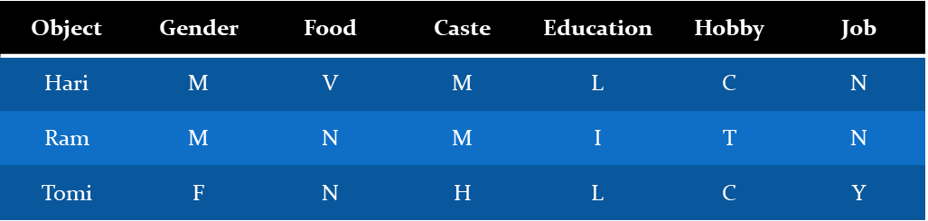
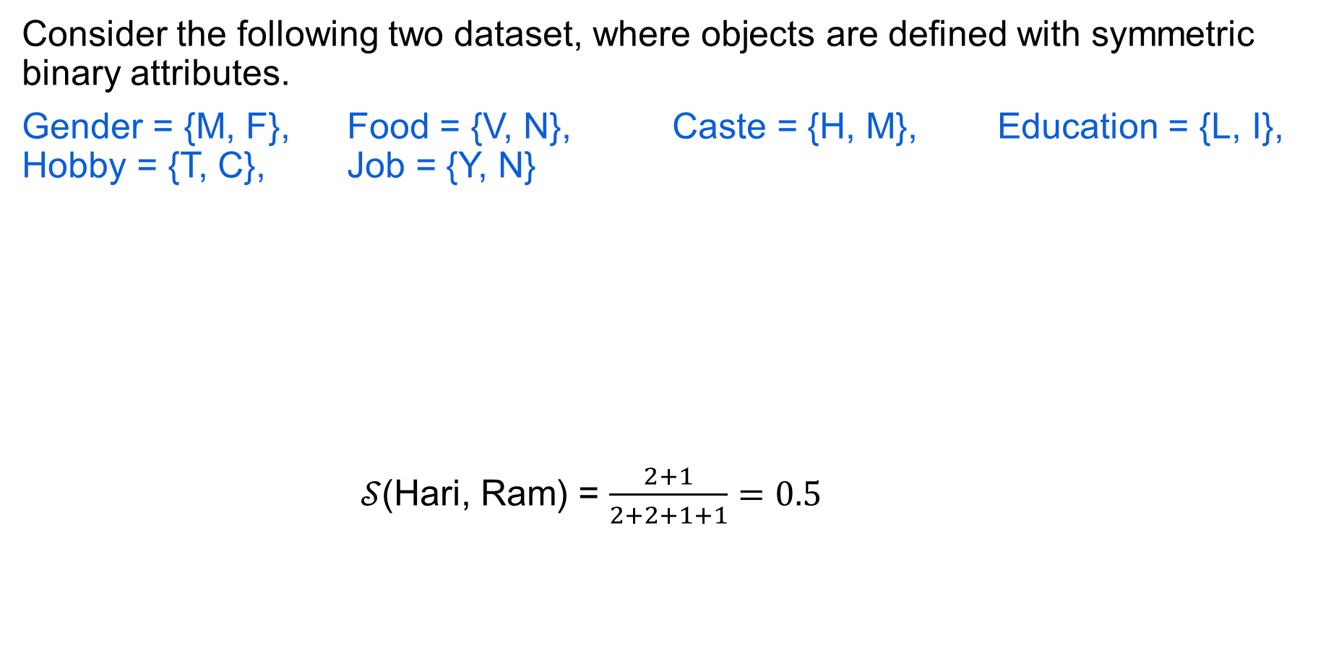
Similarity Measure with Symmetric Binary
Consider the following two dataset, where objects are defined with symmetric binary attributes.
Gender = {M, F}, Food = {V, N}, Caste = {H, M}, Education = {L, I}, Hobby = {T, C}, Job = {Y, N}
$𝒮\text{(}\text{Hari}\text{, }\text{Ram}\text{)}$ = $\frac{2+1}{2+2+1+1}=0.5$
 | 1 | 0
1 | 1 | 1
0 | 2 | 2

Slide 9
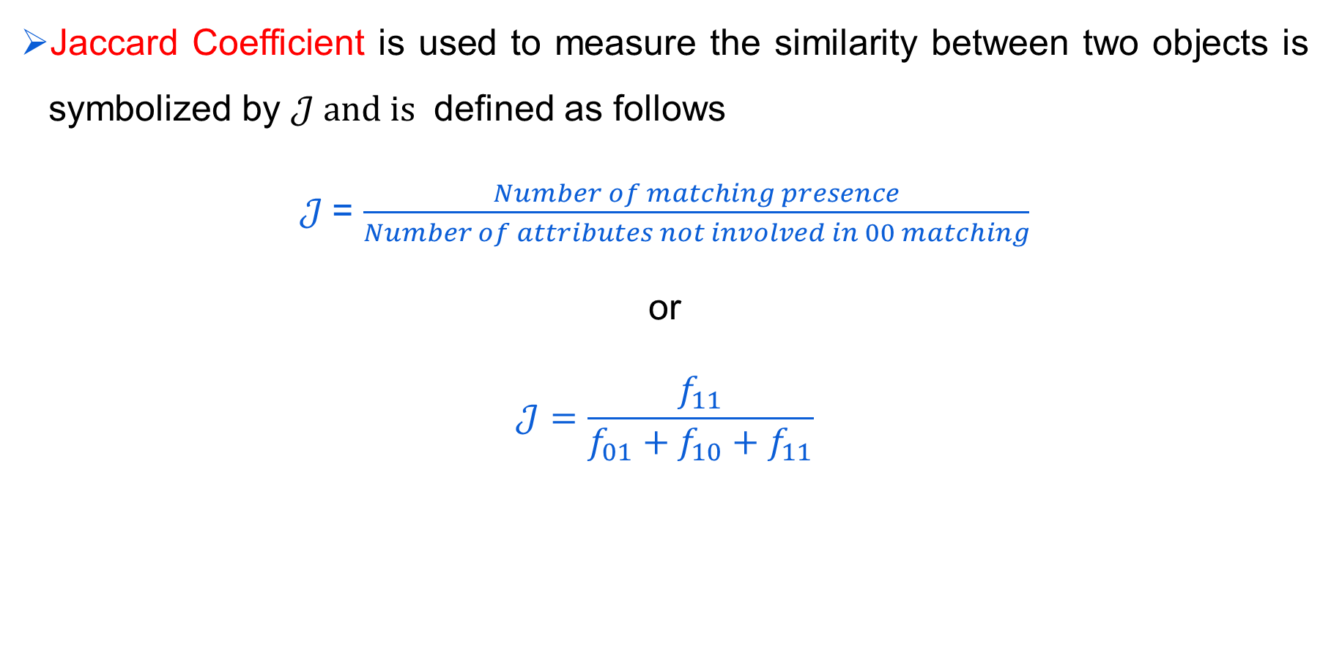
Proximity Measure with Asymmetric Binary
Jaccard Coefficient is used to measure the similarity between two objects is symbolized by $𝒥 and is$ defined as follows
$𝒥$= $\frac{Number of matching presence}{Number of attributes not involved in 00 matching}$
or
$$𝒥=\frac{f_{11}}{f_{01}+f_{10}+f_{11}}$$

Slide 10
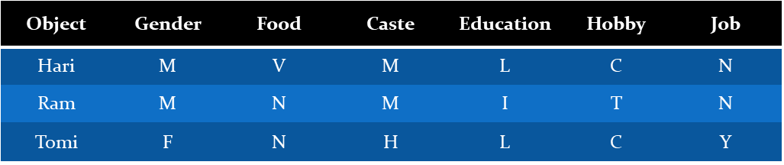
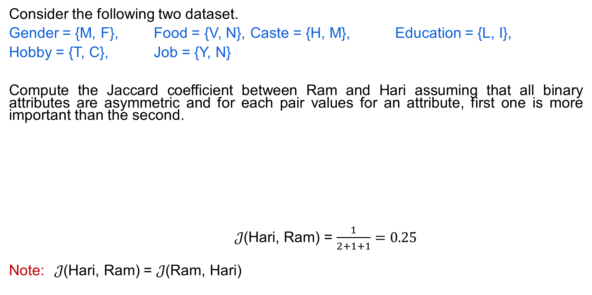
Proximity Measure with Asymmetric Binary
Consider the following two dataset.
Gender = {M, F}, Food = {V, N}, Caste = {H, M}, Education = {L, I},
Hobby = {T, C}, Job = {Y, N}
Compute the Jaccard coefficient between Ram and Hari assuming that all binary attributes are asymmetric and for each pair values for an attribute, first one is more important than the second.
$𝒥\text{(}\text{Hari}\text{, }\text{Ram}\text{)}$ = $\frac{1}{2+1+1}=0.25$
Note:$𝒥\text{(}\text{Hari}\text{, }\text{Ram}\text{)}$ = $𝒥\text{(}\text{Ram}\text{, }\text{Hari}\text{)}$
 | 1 | 0
1 | 1 | 1
0 | 2 | 2

Slide 11
Thank You!
In our next session: Proximity measures for categorical attributes

